Slide 1
Introduction to windows presentation foundation
Client Technology Solutions

Slide 2
Contents
What is WPF?
WPF Architecture
Why WPF?
Fundamentals
  XAML
  Dependency Properties
  Logical v/s Visual Tree
  Routed Events
Layouts
Data Binding
Styles & Templates

Slide 3
What is WPF?
WPF is Microsoft’s next generation UI framework to create applications with rich user experience
It is part of the .NET framework 3.0 and higher
WPF combines application UIs, 2D graphics, 3D graphics, documents and multimedia into one single framework
Its vector based rendering engine uses hardware acceleration of modern graphics card. This makes the UI faster, scalable and resolution independent

Slide 4
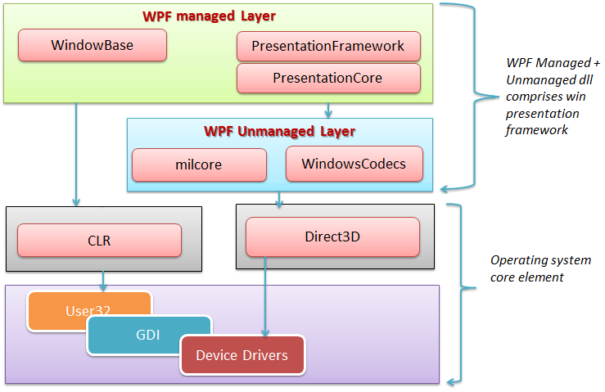
WPF Architecture
WPF is actually a set of assemblies that build up the entire framework. These assemblies can be categorized as:
  Managed Layer
    PresentationFramework.dll
    PresentationCore.dll
    WindowBase.dll
  Unmanaged Layer
    MILCore.dll
    WindowsCodecs.dll
  Core API
    Direct3D
    User32
    GDI & Device Drivers
Notes:
Managed Layer – it is build using no of assemblies. These assemblies build up the WPF framework, communicate with lower level unmanaged API to render its content
PresentationFramework.dll – Creates the top level elements like layouts, panels, controls, windows, styles etc.
PresentationCore.dll – it holds base types such as UIElement, visual from which all shapes and controls are derived in PresentationFramework.dll
WindowBase.dll – it holds even more basic elements which are capable of being used outside the WPF environment like Dispatcher/Dependency object
Unmanaged Layer
Milcore.dll – the unmanaged layer of WPF is called milcore.dll OR Media Integration Library core. It basically translates the WPF higher level objects like layout panels, buttons, animations etc. into textures that Direct3D expects. It is the main rendering engine of WPF.
WindowsCodecs.dll - This is another low level API which is used for imaging support in WPF applications. WindowsCodecs.dll comprises a number of codecs which encode / decode images into vector graphics that would be rendered into WPF screen.
Direct 3D - It is the low level API in which the graphics of WPF is rendered.
User32 - It is the primary core API which every program uses. It actually manages memory and process separation.
GDI & Device Drivers - GDI and Device Drivers are specific to the operating system which is also used from the application to access low level APIs.

Slide 5



Why WPF?
Separation of Appearance and Behavior
Rich composition
Highly customizable
Resolution independent
Multimedia support
Skinning support
Powerful Data Binding

Slide 6
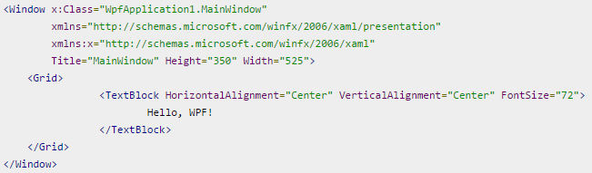
Fundamentals
XAML
  XAML stands for eXtensible Application Markup Language
  It’s a simple language based on XML to create and initialize the objects with hierarchical relations
  Used to create user interfaces in WPF, Silverlight, declare workflows in Windows Work Flow, and for electronic paper in the XPS standard
  All classes in WPF have parameter-less constructors and make excessive usage of properties to make it perfectly fit for XAML
  All you can do in XAML can also be done with code, however it has more advantages over it. Such As:
    XAML code is short and easy to read
    Separation for designer code and business code
    Expression Blend require XAML as source
    The separation of XAML and Code allow it to clearly separate the roles of designer and developer

Slide 7
Fundamentals – Continued
Dependency Properties
  WPF comes with a completely new technique of defining a property of a class/control. The unit of the new property system is Dependency Property and the wrapper class which can create a dependency property is called DepedencyObject
  It looks quite similar to normal .NET properties, but the concept behind is much more complex and powerful
  Difference – value of a normal property is read directly from a private member, whereas value of a dependency property is resolved dynamically by calling the GetValue() that is inherited from DependencyObject
  Advantages
    Property Value Inheritance
    Data Validation
    Participation in Animation\Templates\Styles
    Data Binding
    Callbacks

Slide 8
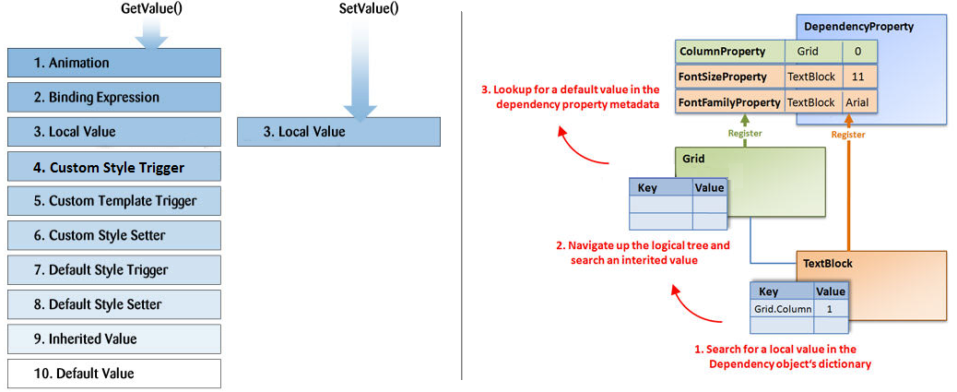
Fundamentals – Continued
Dependency Properties – The magic behind it

Slide 9
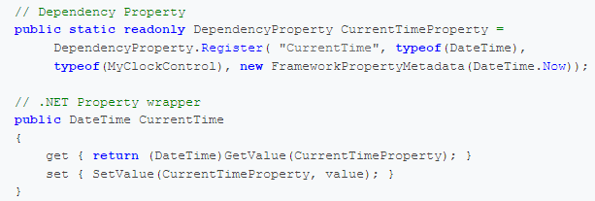

Fundamentals – Continued
Dependency Properties – Example
To register for Callback, value coercion and validation

Slide 10
Fundamentals – Continued
Logical v/s Visual Tree
  Elements of a WPF user interface are hierarchically related. This relation is called “Logical Tree”. The template of one element consist of multiple visual elements. This tree is called “Visual Tree”
  The logical tree describes the relations between elements of user interface and it is responsible for
    Inherit DependencyProperty values
    Resolving DynamicResources references
    Looking up element names for binding
    Forwarding RoutedEvents
  The visual tree contains all logical elements including all visual elements of the template each element and it is responsible for
    Rendering visual elements
    Propagate element Opacity and IsEnabled property
    Propagate Layout and Render Transforms
    Do Hit-Testing
    Relative Source (FindAncestor)

Slide 11
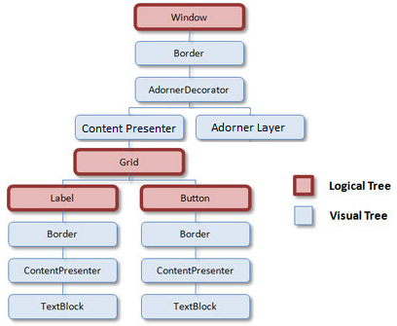
Fundamentals – Continued
Logical v/s Visual Tree – Example

Slide 12
QUESTIONS?
THANK YOU

Slide 13
Recommended URL on the NET
1. Dependency Properties
http://www.wpftutorial.net/DependencyProperties.html
http://www.codeproject.com/Articles/140620/WPF-Tutorial-Dependency-Property
https://msdn.microsoft.com/en-us/library/system.windows.dependencyproperty(v=vs.110).aspx
https://msdn.microsoft.com/en-us/library/vstudio/ms752914(v=vs.100).aspx
2. Logical v/s Visual Tree
http://www.wpftutorial.net/LogicalAndVisualTree.html
http://blogs.msdn.com/b/mikehillberg/archive/2008/05/23/of-logical-and-visual-trees-in-wpf.aspx

